Slide 1
M10

Slide 2
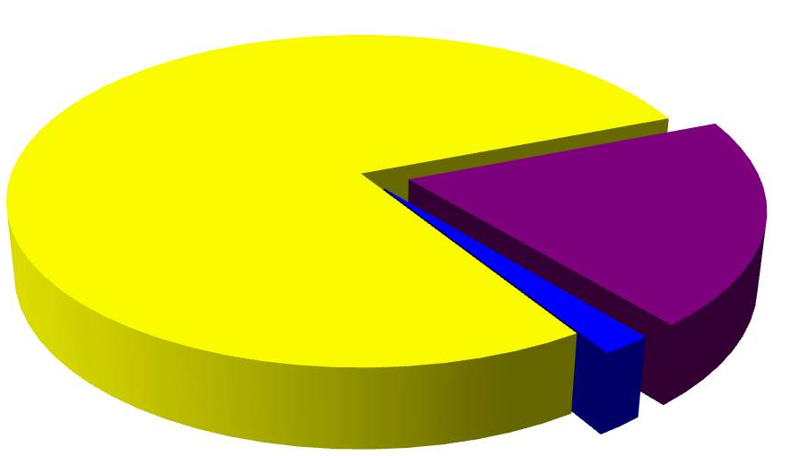
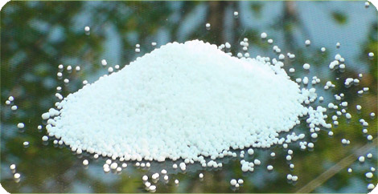
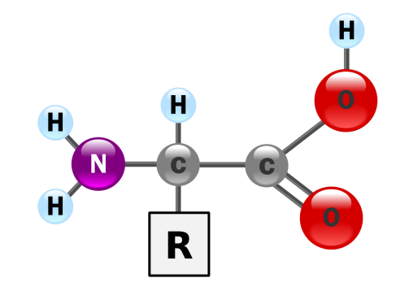
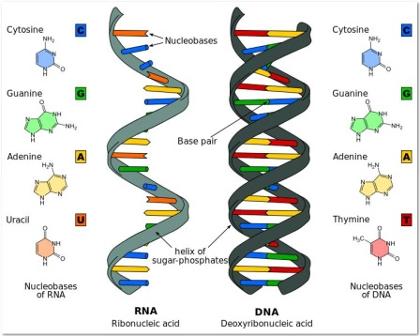
The nitrogen cycle
Nitrogen gas makes up 78% of our atmosphere
78% Nitrogen
Nitrogen is also a part of many molecules essential to life like proteins, nucleic acids (DNA and RNA) and some vitamins.
Nitrogen is found in other biologically important compounds such as alkaloids and urea too.

Slide 3
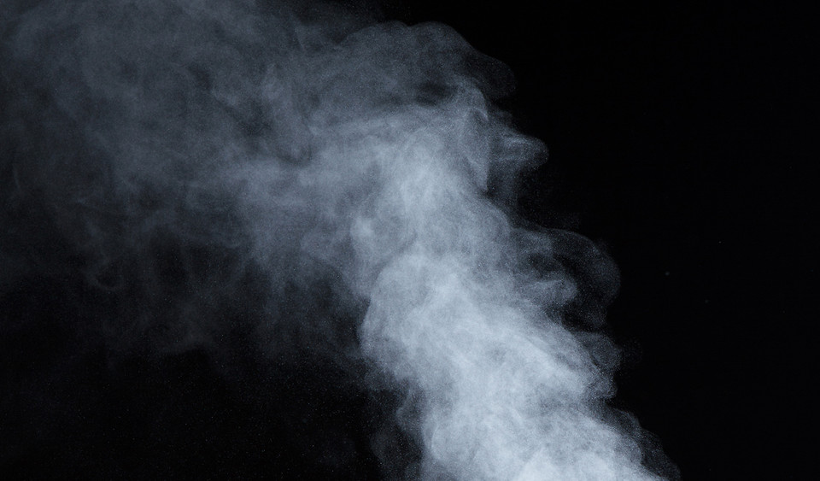
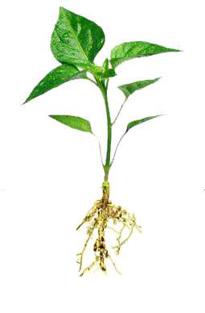

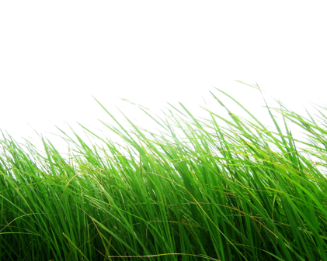
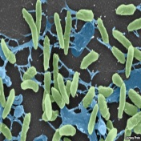

But all living organisms cannot use atmospheric nitrogen directly.
There are few nitrogen fixing bacteria in the soil, which convert atmospheric nitrogen into nitrates and nitrites.
These nitrates and nitrites are then taken up by the plants and used to make the required molecules.
These bacteria also convert atmospheric nitrogen into nitrates and nitrites which are then taken up by plants.
Another way by which nitrogen is converted into nitrates and nitrites is by a physical method.
During lightning, the high temperature and pressure created in the air convert nitrogen in to oxides of nitrogen.
These oxides dissolve in water to give nitric and nitrous acid and fall on land long with rain.
These are then utilized by various life forms.
Nitrogen fixing bacteria are also present in root nodules of legumes.
Now from the soil these nitrites and nitrates are taken up by plants and converted into amino acids which are use to make proteins.
These proteins subsequently enter the bodies of animal when the plants are consumed by animals.
Once the animal or the plant dies, other bacteria in the soil convert the various compounds of the nitrogen back into nitrates and nitrites.
A different type of bacteria converts the nitrates and nitrites into elemental nitrogen.
Thus , there is nitrogen-cycle in nature in which nitrogen passes from its elemental form in the atmosphere into simple molecules in the solid and water, which get converted to more complex molecules in living beings and back again to the simple nitrogen molecule in the atmosphere.
Generally the plants which gives us pulses
HNO₃
HNO₂
O₂
NO₃⁻
N₂
N₂
N₂
O₂
P
AA
P
P
N₂
N₂
NO₃
NO₂
NO₃
NO₂ ⁻
NO₂
NO₃
NO₂
NO₃

